Slide 1
Cyclistic Case Study
Google Data Analytics Certificate
14th October 2021
Capstone Project

Slide 2
Contents
Item # | Description | Slide #
1 | Introduction | 3
2 | Key Objectives | 4
3 | Preparing and Processing the Data | 6
4 | Analysing and Visualizing the Data | 7
5 | Summary of Key Findings | 13
6 | Recommendations | 14
A1 | Appendix | 15

Slide 3

1. Introduction
This case study was completed as a Capstone project as part of the Google Data Analytics Certificate. It is based on a fictional company and used public data made available by Motivate International Inc.
Cyclistic is a bike sharing company that has 5,800 bicycles which are geo-tracked and locked into a network of 692 stations across Chicago. The company want to analyze the usage of their bikes in order to gain insights into how casual riders and members use bikes differently.
Then, using this information the CEO would like high level recommendations for designing marketing strategies to convert casual riders into annual members to increase sales.

Slide 4
2. Key Objectives (1 of 2)
Identify the Business Task
Cyclistic’s finance analysts have concluded that annual members are much more profitable than casual riders. With this in mind, the business objective is to increase sales by converting casual riders to members. My task as a junior data analyst is:
Identify how annual members and casual riders use Cyclistic bikes differently.
These insights will be used by the marketing team to develop a campaign aimed at converting casual riders to members by purchasing an annual membership.
The business task is to produce a report which outlines the following:
A clear statement of the business task
A clear description
of all data sources used
Documentation of any cleaning or manipulation of data
Supporting visualizations of key findings
Top 3 recommendations based on the analysis
A summary of the analysis

Slide 5
2. Key Objectives (2 of 2)
Consider Key Stakeholders
Cyclistic - A bike share program that features more than 5,800 bicycles and 600 docking stations. Cyclistic sets itself apart by also offering reclining bikes, hand tricycles, and cargo bikes, making bike-share more inclusive to people with disabilities and riders who can’t use a standard two-wheeled bike. The majority of riders opt for traditional bikes; about 8% of riders use the assistive options. Cyclistic users are more likely to ride for leisure, but about 30% use them to commute to work each day.
Lily Moreno - Director of Marketing and my manager
Cyclistic Marketing Analytics Team - A team of data analysts who are responsible for collecting, analyzing, and reporting data that helps guide marketing strategy
Cyclistic Executive Team – they will decide whether to approve the recommended marketing program
Hypothesis
Mean trip duration will be longer for casual riders than for members. Members are likely to use the bike for commuting to work, whereas casual riders are more likely to cycle for pleasure at a leisurely pace
Usage will spike for casual riders over the weekend
Usage will increase during the warmer months
Start and end stations in the tourist areas will be popular for casual riders as tourists want to see the city by bike
I would also expect members to cycle more frequently than casual riders however this can not be analyzed due to data-privacy issues prohibiting me from using riders’ personally identifiable information.

Slide 6
3. Preparing and Processing the Data
The data set is sourced from public data compiled by Motivate International Inc. 12 months of data has been used which is approximately 4 million records. Given the quantity of data, I have decided to use R as the main analytics tool.
Data has needed to be cleaned due to a number of duplicate records, missing data and invalid data.
Below is a link to the data:
http://divvy-tripdata.s3.amazonaws.com/index.html

Slide 7
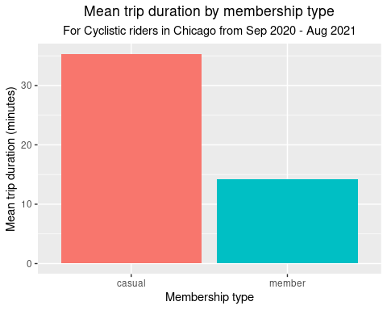
4. Analysing and Visualizing the Data (1 of 6)
Mean trip length is significantly higher for casual riders (35 mins) than for members (14 mins).
This is likely to be due to casual riders cycling at a leisurely pace, versus members who may be commuting to work.

Slide 8
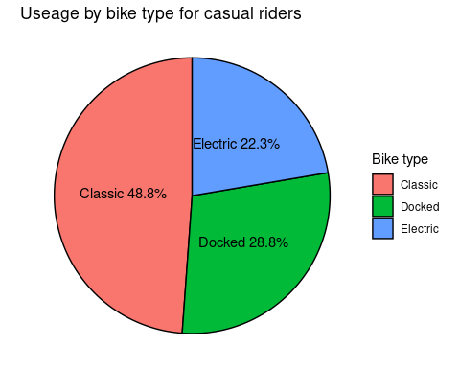
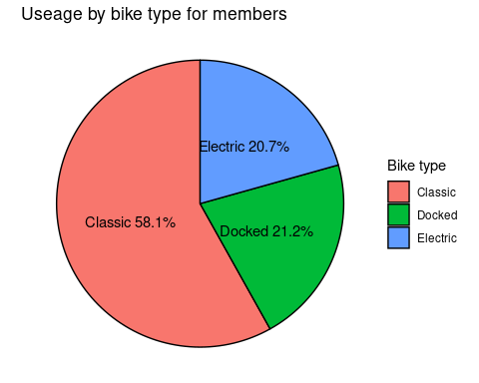
4. Analysing and Visualizing the Data (2 of 6)
Usage by bike type for casual riders
Usage by bike type for members
Bike type usage is the same for casual riders and members with respect to ranking. That is, the most popular
bike is the Classic, followed by Docked then Electric.
By far the most popular bike for casual riders and members is the Classic, with usage rates being double that of the second most popular type, the Electric.

Slide 9
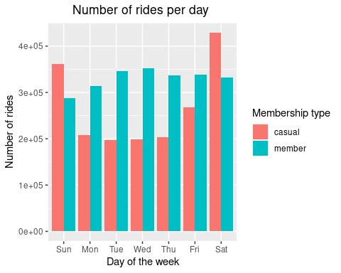
4. Analysing and Visualizing the Data (3 of 6 )
Saturdays and Sundays are the most popular days for trips, this is with casual riders. The least popular days are Tuesday to Thursday, again with casual riders.
The variance between days of the week fluctuates significantly more for casual riders than for members.
The number of rides is higher for members than casual riders for weekdays. This changes in the weekend when more rides are by casual riders than by members.
The number of rides for members is relatively consistent, irrespective of the day of the week, with the slight exception for Sunday. This is not surprising given we’ve been advised 30% of Cyclistic riders use the bikes to commute to work each day, and frequent riders are more likely to be members. Sunday is a day of rest for many.

Slide 10
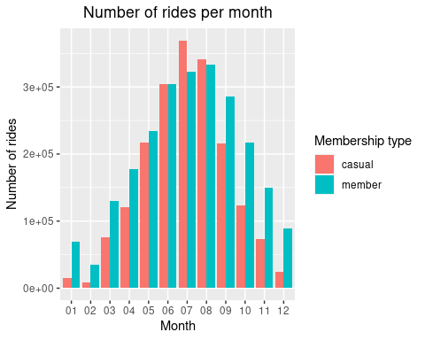
4. Analysing and Visualizing the Data (4 of 6)
Demand for Cyclistic bikes is seasonal with demand increasing during Summer and decreasing during Winter. This is the case for both casual riders and members.
There is a correlation between usage and seasons for casual riders and members.

Slide 11
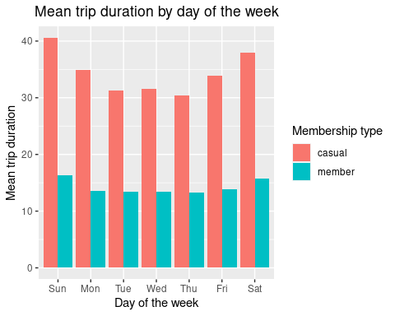
4. Analysing and Visualizing the Data (5 of 6)
The longest trip length is for casual riders on Saturdays and Sundays with trip length dipping mid week. Riders are likely to have more time during the weekend and can cycle at a more leisurely pace.
Trip duration is more consistent for members which is what we would expect given 30% of Cyclistic riders commute to work, and we can reasonably assume that a high proportion of these commuters will be members.

Slide 12
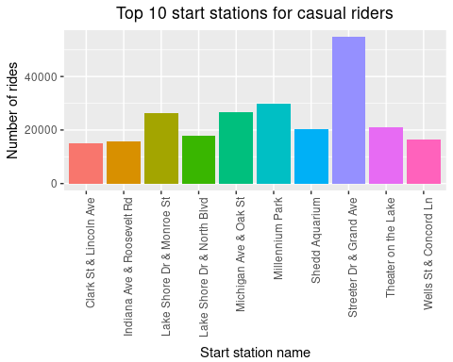
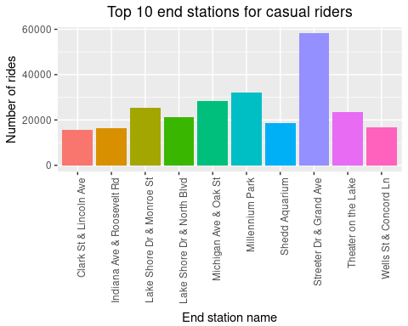
4. Analysing and Visualizing the Data (6 of 6)
While this visualization is not directly related to the business task, it provides valuable insights as to which stations are the most popular for casual riders. These insights could then be used by the marketing team to concentrate their marketing efforts in a more targeted manner.
There are significantly more casual riders starting/ ending trips at Streeter Dr/ Grand Ave so this could be the best place to focus marketing – provided the high numbers are not largely attributable to visitors as they are unlikely to purchase annual memberships.

Slide 13

5. Summary of Key Findings for Cyclistic Riders
Trip duration is longer for casual riders than for members
Most the week day cyclists are members, where as most of the weekend cyclists are casual riders
Significantly more casual riders start or finish at Streeter Drive/ Grand Ave than any other station with
the count being over double the second highest ranked station
4. The most popular bike type is the same for casual riders and members; the Classic
5. The mean trip duration for casual riders is over double the mean trip duration for members for every day of the week
6. There is more variance in trip length depending on the day of the week for casual riders than for members
7. Bike usage is seasonal with demand increasing during the warmer months for both casual riders and members

Slide 14

6. Recommendations
Based on the above findings my top 3 recommendations are:
Streeter Drive/ Grand Ave is the most popular station for casual riders. Cyclistic could have an advertising presence in this area eg. digital bus stop advertising or billboards. Alternatively, special deal brochures could be handed out at popular stations during peak season.
It would be good to know whether the increased demand during Summer is due to an increased number of visitors or more locals enjoying rides due to improved weather conditions. If it is mainly due to visitors, it’s unlikely these people will convert to annual membership as it will not be cost effective to do so. A survey could be taken with riders near popular stations and analysis done to assess what proportion of casual riders are locals vs visitors. If the outcome of such analysis reveals increased usage is mainly due to locals, increased marketing spend could be employed during the summer months.
The ride length for casual members is significantly lower for week days than it is for weekends. This suggests that some riders are using the bikes to commute to work. Perhaps these users are not aware there is an option to purchase an annual membership which would be a more cost effective option. A marketing campaign could be employed to raise awareness of this option and to include the cost benefit of becoming a member.

Slide 15
A1. Appendix
To view more information on the process and script please view my R Markdown file in Github:
>> Link

